Slide 1
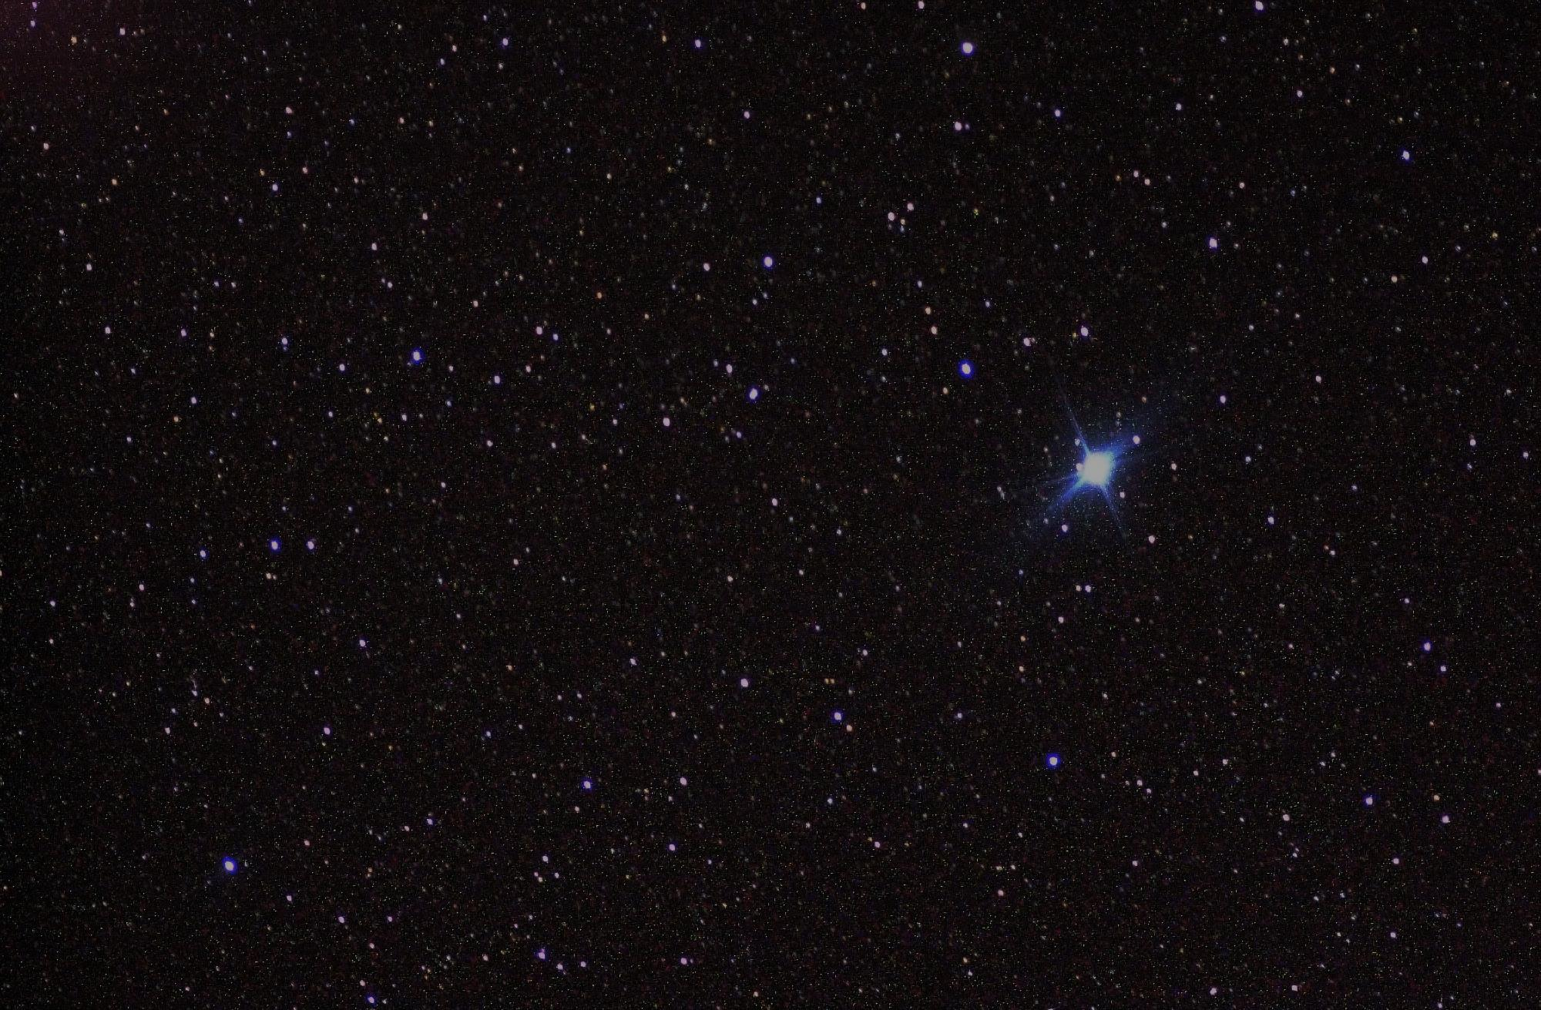
What happens to photon correlations
when you keep the frequency information
Fabrice P. Laussy
Universidad Autónoma de Madrid & Russian Quantum Center
http://laussy.org
with:
E. del Valle, C. Sánchez Muñoz, A. González Tudela,
S. Lichtmannecker, K. Müller, M. Kaniber, C. Tejedor, J.J. Finley,
B. Silva, M. de Giorgi, L. Dominici, D. Balarini, D. Sanvitto.

Slide 2
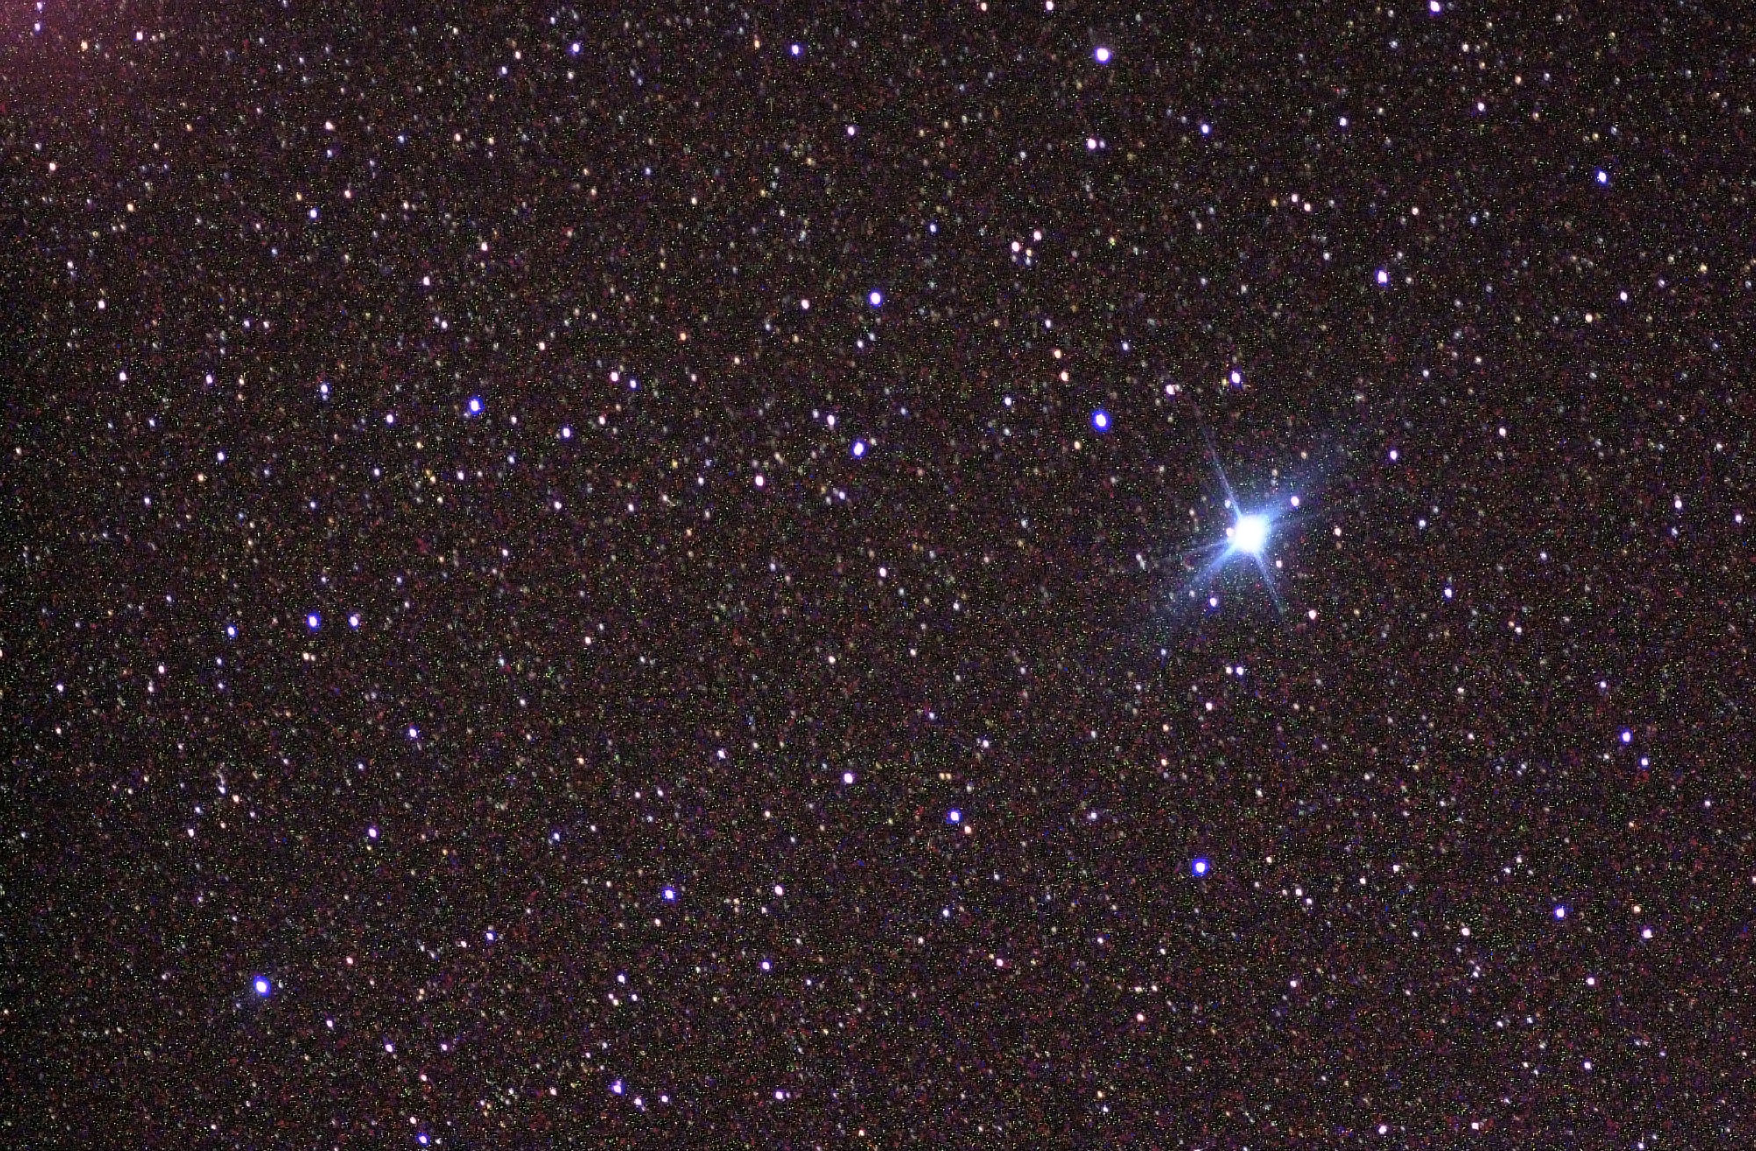
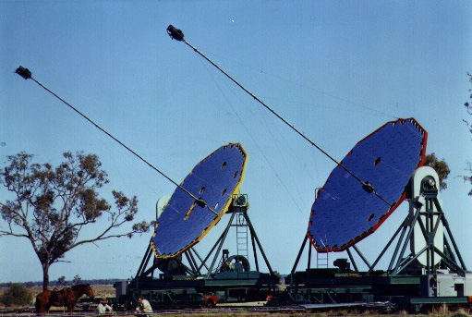
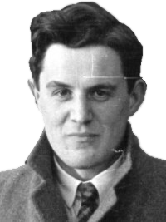
What happens to photon correlations
when you keep the frequency information
Robert
Hanbury
Brown

Slide 3
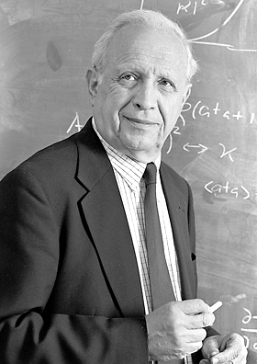
g^{(2)­}(t,τ): Glauber’s theory
Second-order correlation function
Roy J. Glauber

Slide 4
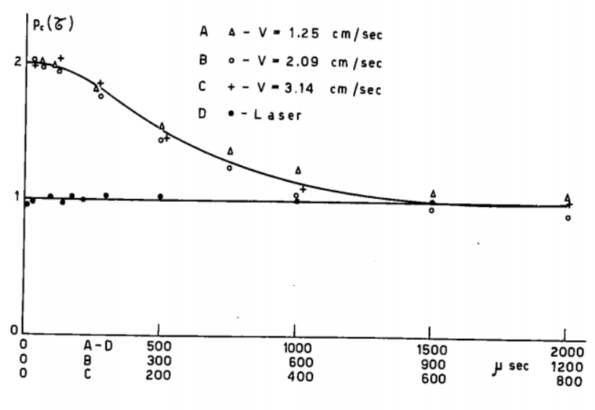
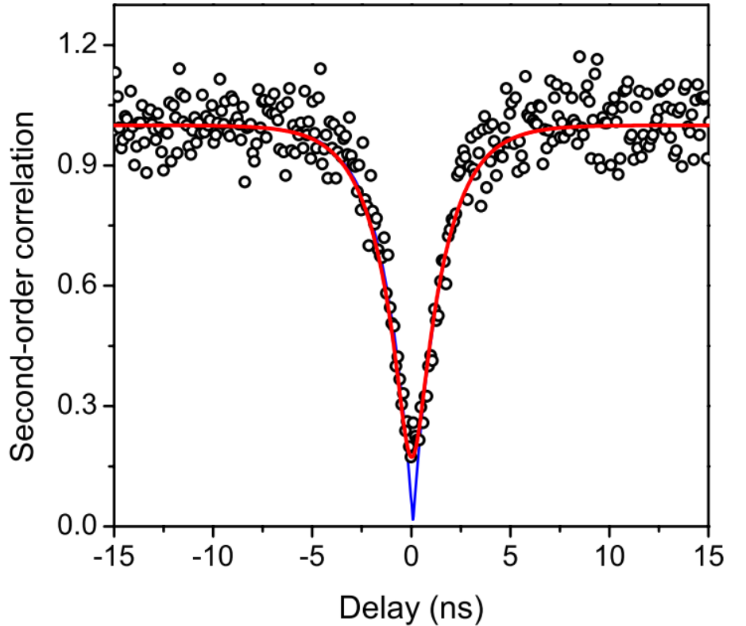
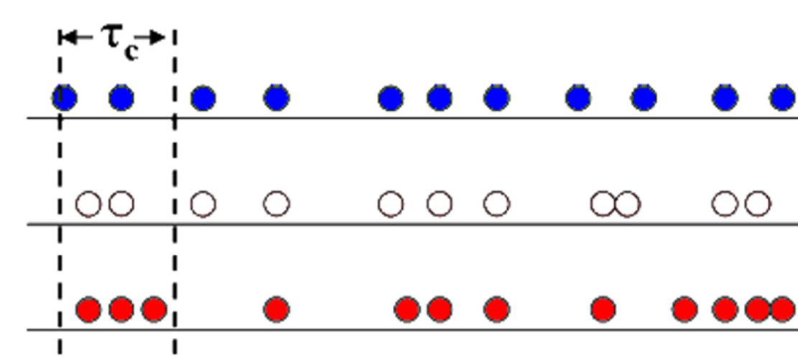
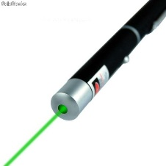
g^{(2)­}(t,τ): Glauber’s theory
Second-order correlation function
Roy J. Glauber

Slide 5
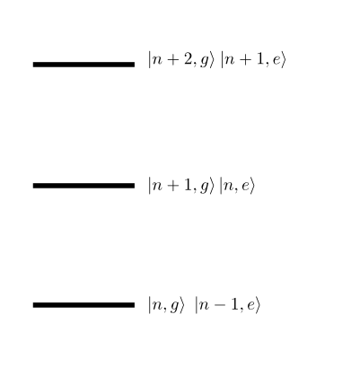
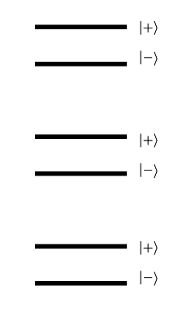
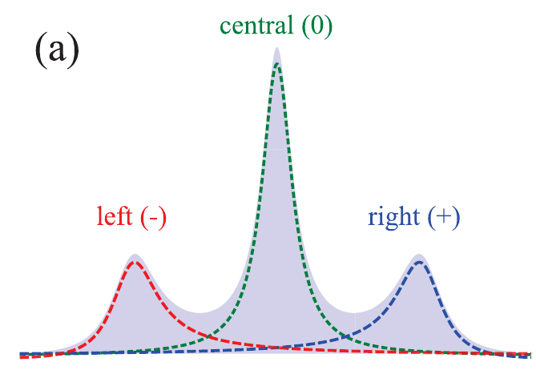
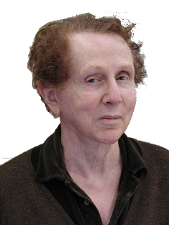
Mollow
Benjamin
Mollow triplet

Slide 6
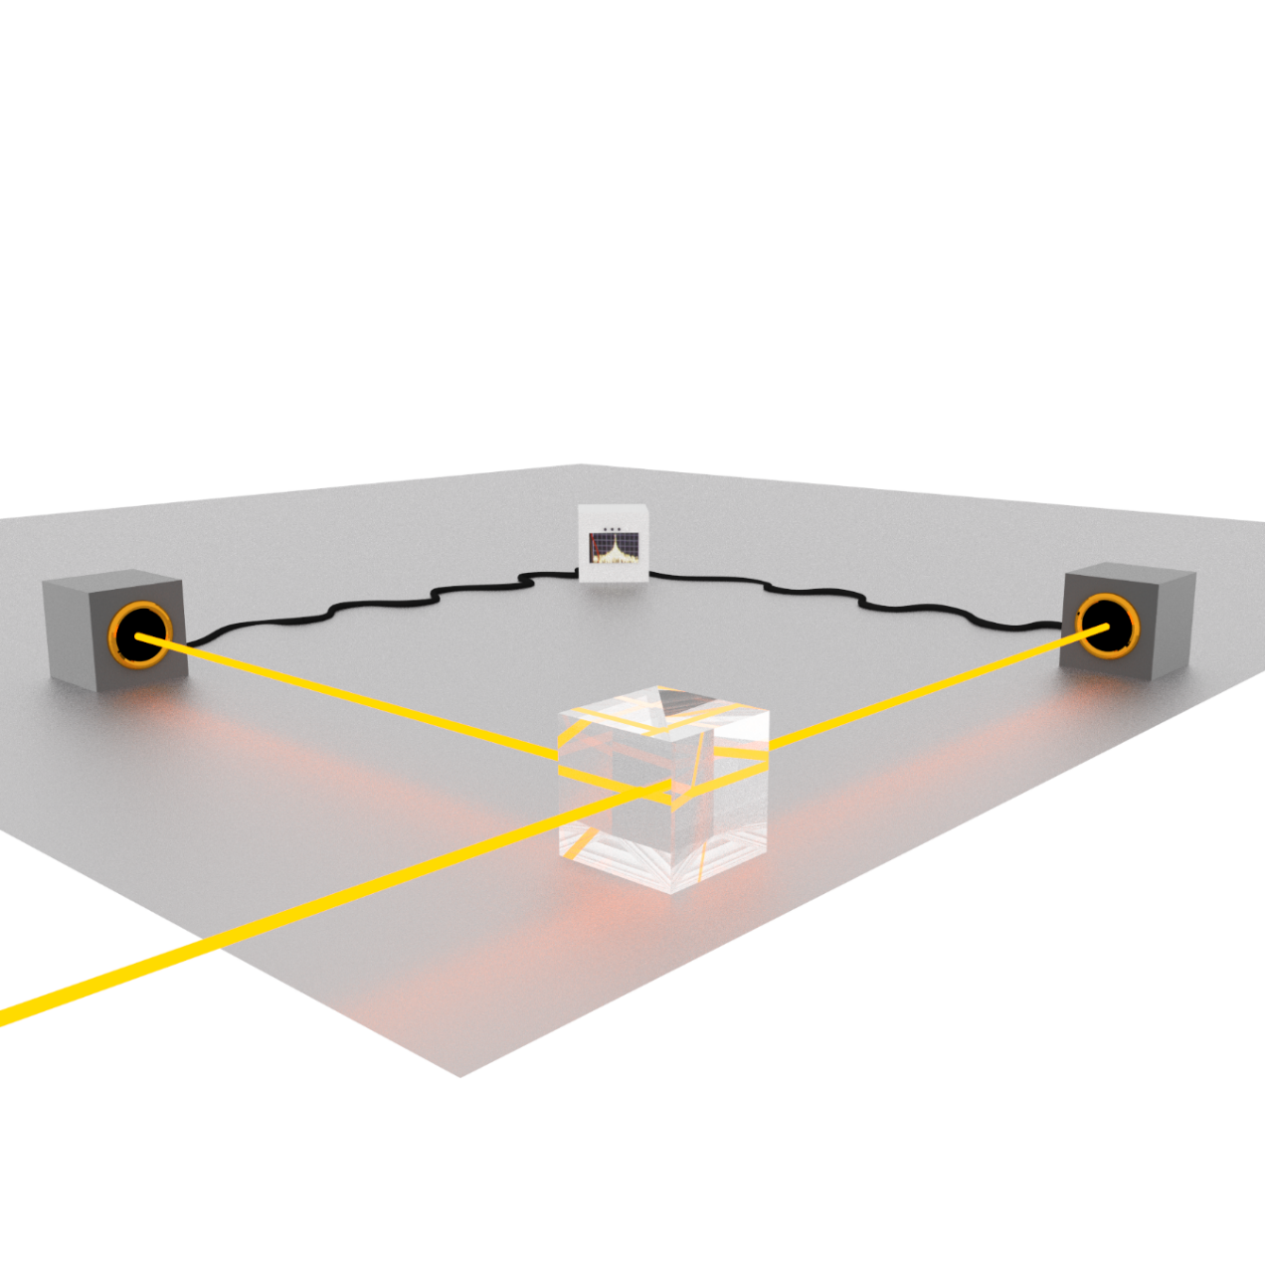
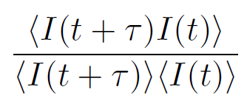
Mollow triplet

Slide 7
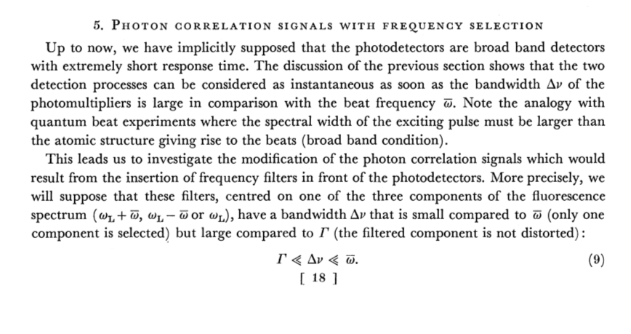
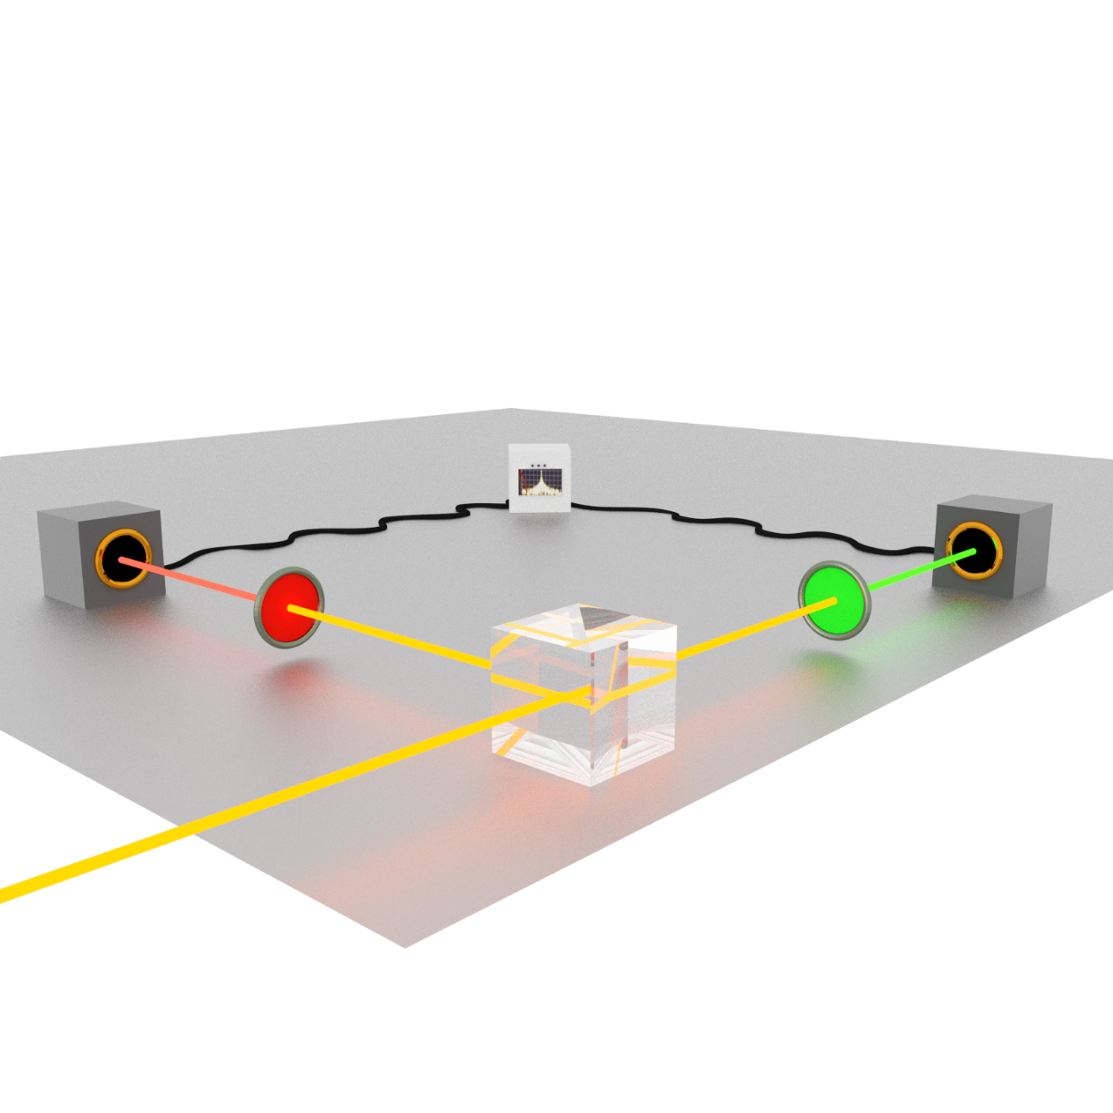
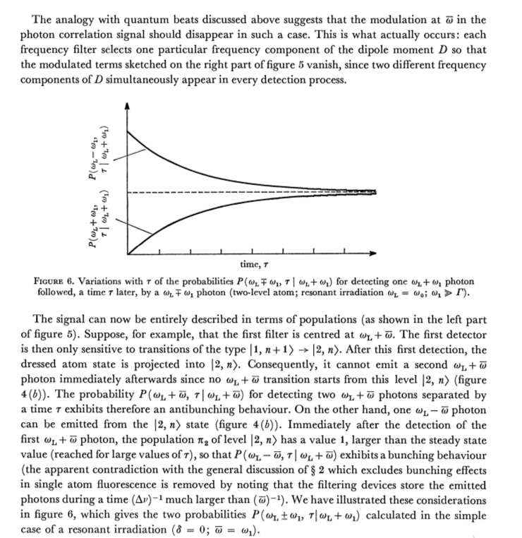
C. Cohen-Tannoudji et al., "Atoms in Strong Light-Fields: Photon Antibunching in Single Atom Fluorescence",
Philosophical Transactions of the Royal Society of London. 223, 293 (1979)
Mollow triplet

Slide 8
The theory of frequency- and
time- two-photon correlations
is theoretically challenging…
See, e.g.,
L. Knöll and G. Weber, J. Phys. B 19, 2817 (1986)
K. Joosten and G. Nienhuis, J. Opt. B 2, 158 (2000)
G. Bel and F. L. H. Brown, Phys. Rev. Lett. 102, 018303 (2009)
Via the input-output formalism, convolution with detectors:
4!/2 = 12 independent correlators (time orders) with their specific integrating region
Each requires Quantum Regression Theorem 3 times
Very difficult to generalise to N photons correlations

Slide 9
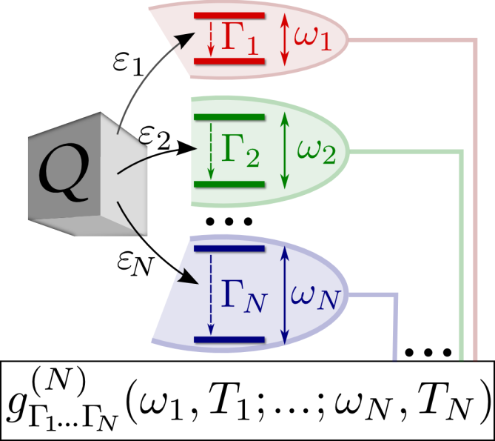
Our theory of frequency- and
time- two-photon correlations
Theory of frequency-filtered and time-resolved N-photon correlations,
E. del Valle et al.,
Phys. Rev. Lett. 109, 183601 (2012)
We propose a general theory valid for
Any number of photons (not only two as in previous studies)
Any quantum open system (not only simple limiting cases)
Steady-state situations under continuous excitation or time dynamics with no approximations.
Computationally powerful and efficient
Includes self-consistently the fundamental detector uncertainty or filtering resolution
(in time/frequency according to Heisenberg uncertainty principle)

Slide 10
Our theory of frequency- and
time- two-photon correlations
Theory of frequency-filtered and time-resolved N-photon correlations,
E. del Valle et al.,
Phys. Rev. Lett. 109, 183601 (2012)
Via including filter/detectors (= “sensors”) in the dynamics:
We solve the full system in the weak coupling limit with the sensors → the system dynamics is unperturbed
We apply the quantum regression theorem only once & no integrals to make!
For t = 0 we only need to look at one-time correlations
We recover exactly the integral result
The technique is simple, exact, general and scalable.

Slide 11
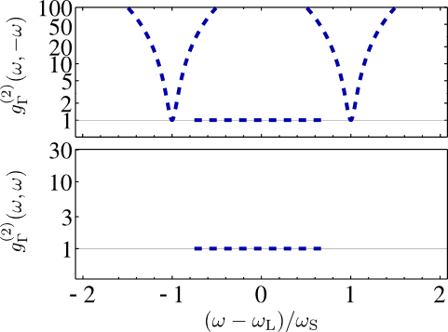
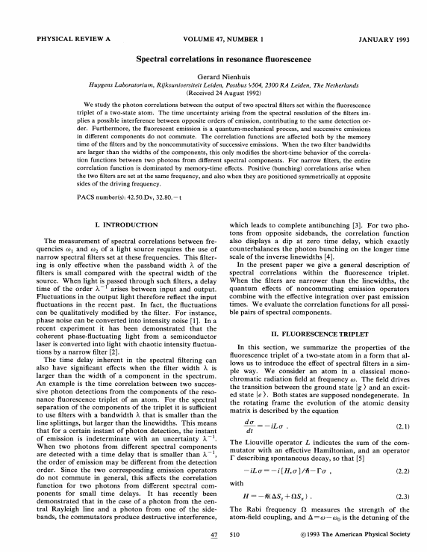
G. Nienhuis, Spectral correlations in resonance fluorescence,
Phys. Rev. A, 47, 510 (1993).

Slide 12
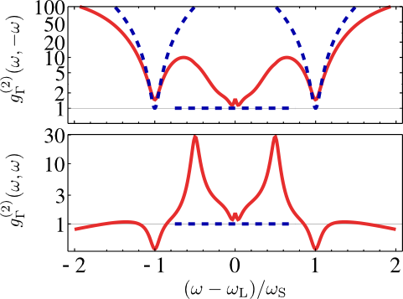
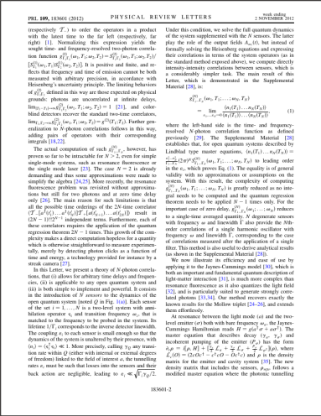
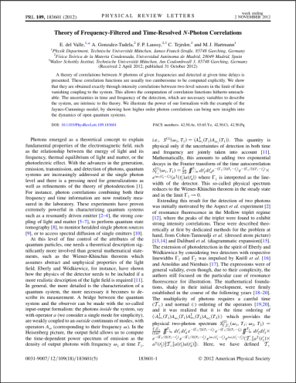
E. del Valle et al.
Theory of frequency-filtered and time-resolved N-photon correlations
Phys. Rev. Lett. 109:18, 183601 (2012)
G. Nienhuis, Spectral correlations in resonance fluorescence,
Phys. Rev. A, 47, 510 (1993).

Slide 13
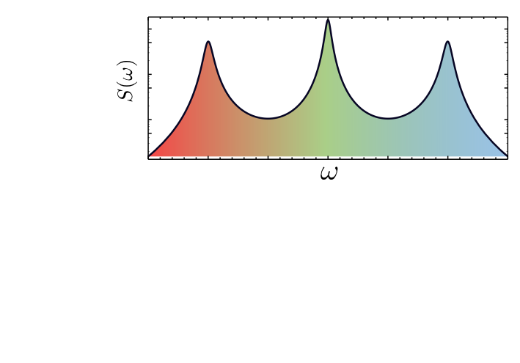
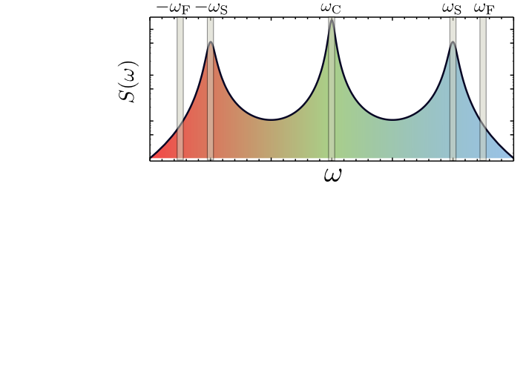
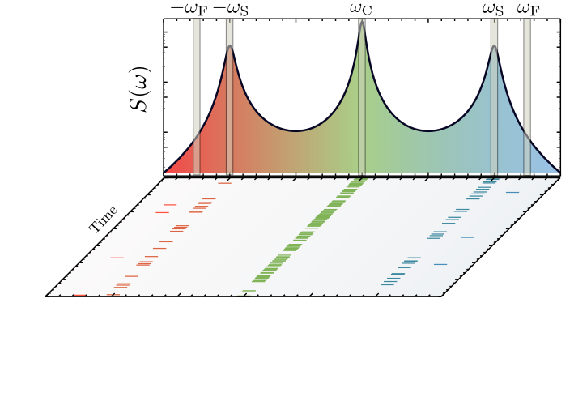
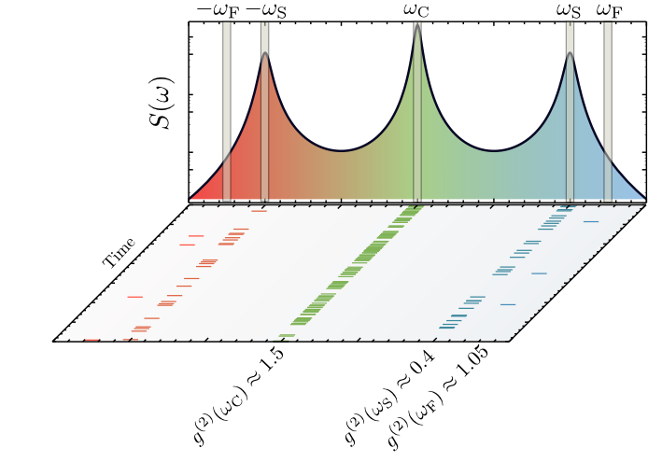
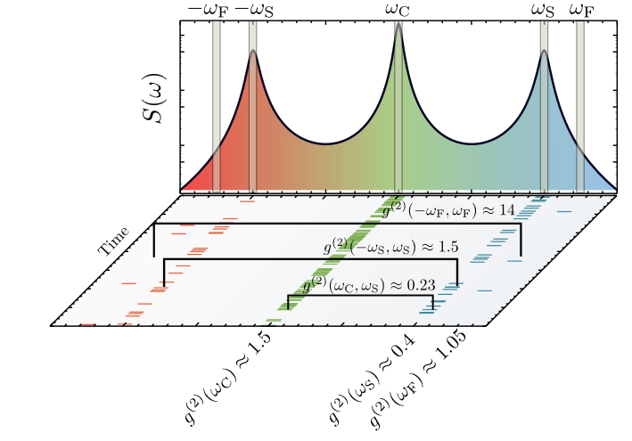

Slide 14
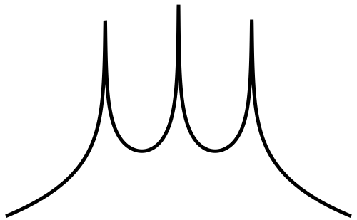
Two-photon spectrum of resonance fluorescence
Two-photon spectra of quantum emitters
Gonzalez-Tudela et al.,
New J. Phys. 15, 033036 (2013)
Notes:
14

Slide 15
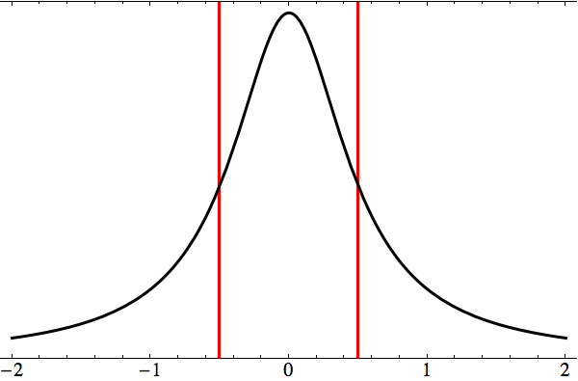
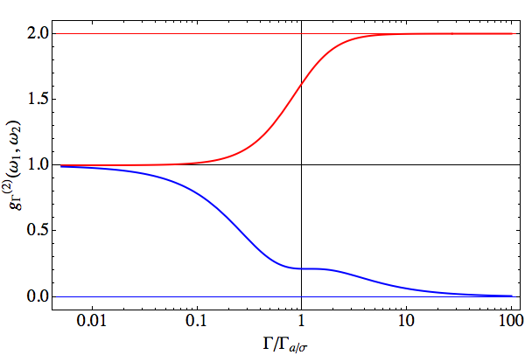
Two-photon spectrum of simple emitters
Two-photon spectra of quantum emitters
A. Gonzalez-Tudela et al.,
New J. Phys. 15, 033036 (2013)
(video abstract at http://goo.gl/409vw7)
harmonic oscillator
two-level system

Slide 16
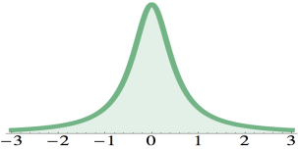
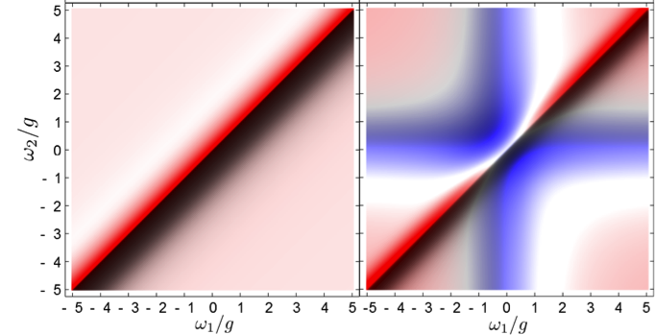
Two-photon spectrum of simple emitters
Two-photon spectra of quantum emitters
A. Gonzalez-Tudela et al.,
New J. Phys. 15, 033036 (2013)
(video abstract at http://goo.gl/409vw7)
harmonic oscillator
two-level system
above 1
below 1

Slide 17
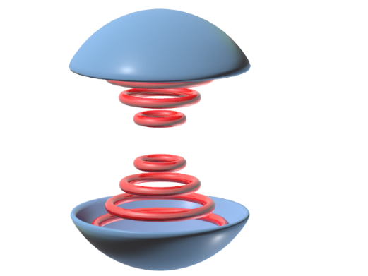
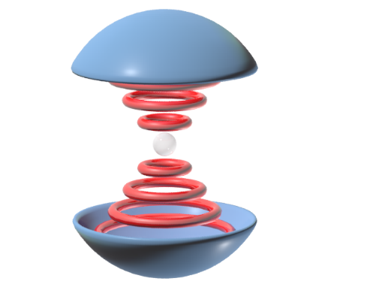
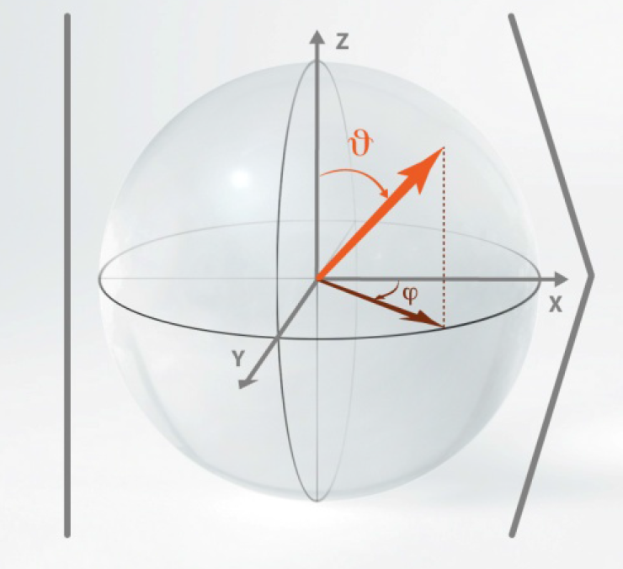
The Jaynes-Cummings hamiltonian
Jaynes-Cummings Ladder

Slide 18
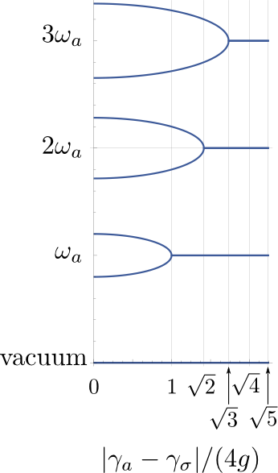
The dissipative Jaynes-Cummings ladder
Luminescence spectra of quantum
dots in microcavities. II. Fermions
del Valle, Laussy & Tejedor
Phys. Rev. B 79, 235326 (2009)

Slide 19
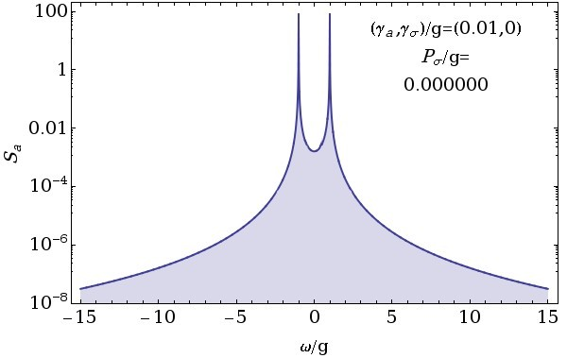
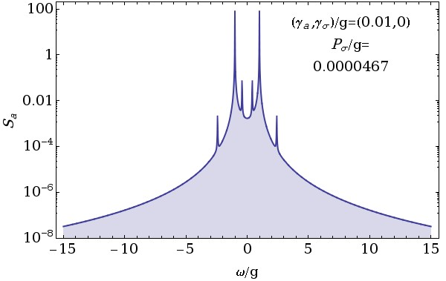
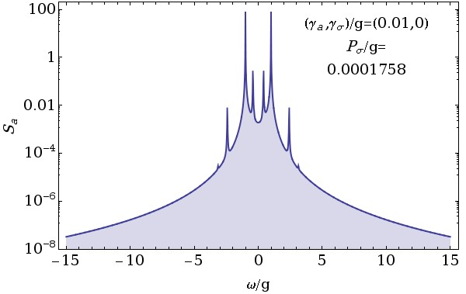
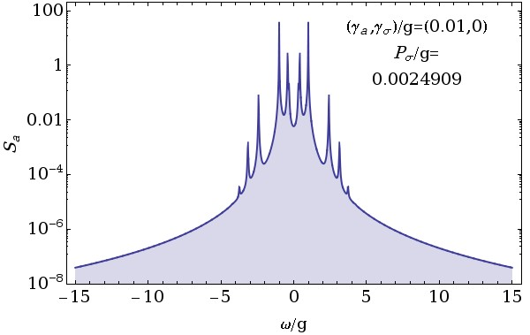
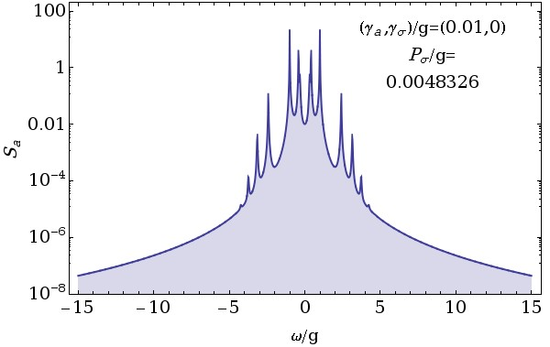
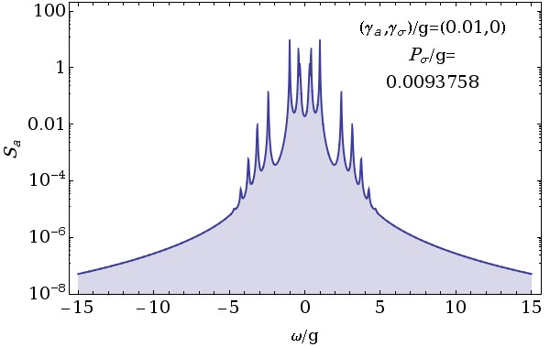
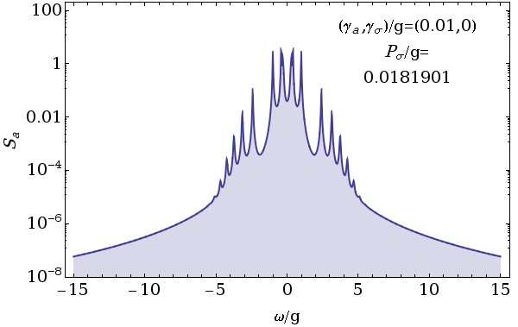
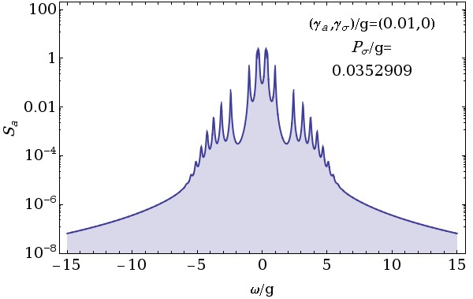
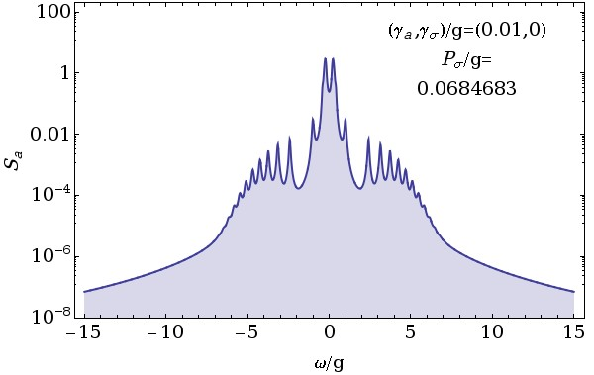
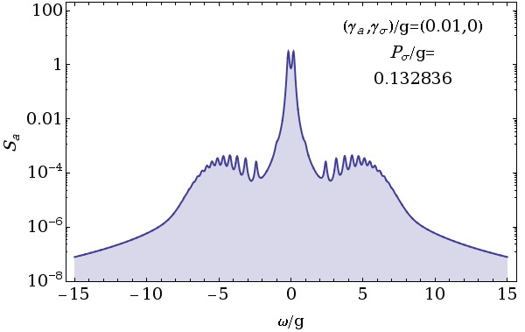
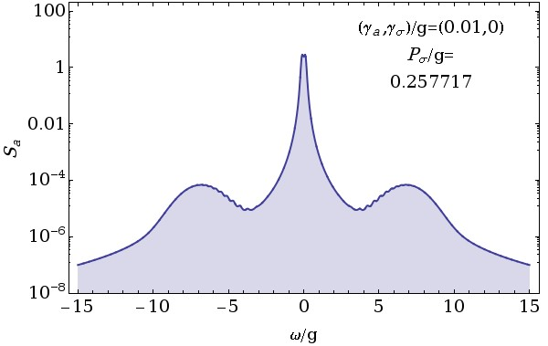
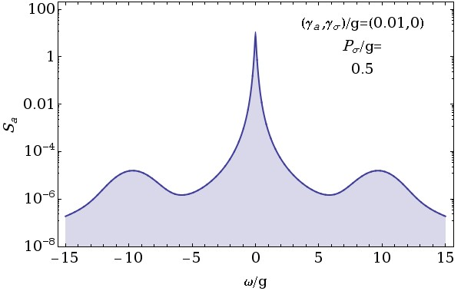
From the Rabi doublet to the Mollow triplet
Notes:
19

Slide 20
The Jaynes-Cummings—Mollow transition
Negative Rayleigh peak
Mollow Triplet
Rayleigh peak
del Valle & Laussy,
PRL 105:233601 (2010)

Slide 21
Experiments in need of some physics
Quantum nature of a strongly coupled single quantum dot–cavity system
K. Hennessy et al., Nature 445, 896 (2007)

Slide 22
Two-photon correlation spectrum of the Jaynes-Cummings model
Ibid: Two-photon spectra of quantum emitters, A. Gonzalez-Tudela et al., New J. Phys. 15, 033036 (2013)

Slide 23
Two-photon correlation spectrum of the Jaynes-Cummings model
Ibid: Two-photon spectra of quantum emitters, A. Gonzalez-Tudela et al., New J. Phys. 15, 033036 (2013)

Slide 24
Two-photon correlation spectrum of the Jaynes-Cummings model
Ibid: Two-photon spectra of quantum emitters, A. Gonzalez-Tudela et al., New J. Phys. 15, 033036 (2013)

Slide 25
Two-photon correlation spectrum of the Jaynes-Cummings model
Ideal
detector
Filter linewidth
mandatory
Ibid: Two-photon spectra of quantum emitters, A. Gonzalez-Tudela et al., New J. Phys. 15, 033036 (2013)

Slide 26
Two-photon correlation spectrum of the Jaynes-Cummings model
Ibid: Two-photon spectra of quantum emitters, A. Gonzalez-Tudela et al., New J. Phys. 15, 033036 (2013)

Slide 27
Three-photon correlation spectrum of the Jaynes-Cummings model

Slide 28
Back to the Mollow triplet
Andreas Muller’s group, University of South Florida

Slide 29
Simpler is not duller: the Boson form factor
CCD detector
Microcavity
Oscillatory
field
Grating
Photocathode

Slide 30
Theory meets experiment

Slide 31
Frequency- and time- resolved photon correlations (experimentally, Sanvitto group in Lecce)

Slide 32
Frequency- and time- resolved photon correlations (experimentally, Sanvitto group in Lecce)
1

Slide 33
Frequency- and time- resolved photon correlations (experimentally, Sanvitto group in Lecce)
2
1

Slide 34
Frequency- and time- resolved photon correlations (experimentally, Sanvitto group in Lecce)
3
2
1

Slide 35
Frequency- and time- resolved photon correlations (experimentally, Sanvitto group in Lecce)
3
2
1
3
2
1

Slide 36
What is it good for?
Enhance violation of classical inequalities
Engineering of a new type of light
see also (for more)
Distilling one, two and entangled pairs of photons from a quantum dot
with cavity QED effects and spectral filtering
E. del Valle, New J. Phys. 15 025019 (2013)

Slide 37
The Cauchy-Schwarz
inequality
Cauchy
Schwarz
Буняко́вский

Slide 38
The Cauchy-Schwarz
inequality
Cauchy
Schwarz
Буняко́вский
In terms of photon correlations
The CSI reads:
1

Slide 39
Bell’s inequality

Slide 40
A new class of photon correlations
g⁽²⁾
Cauchy-Schwarz
Bell
Violation of classical inequalities by frequency filtering
Carlos Sánchez Muñoz, Elena del Valle, Carlos Tejedor, Fabrice P. Laussy
Phys. Rev. A 90, 052111 (2014)

Slide 41
A new class of photon correlations
g⁽²⁾
Cauchy-Schwarz
Bell
Violation of classical inequalities by frequency filtering
Carlos Sánchez Muñoz, Elena del Valle, Carlos Tejedor, Fabrice P. Laussy
Phys. Rev. A 90, 052111 (2014)

Slide 42
Peiris et al.,
arXiv:1501.00898

Slide 44
What is it good for?
Enhance violation of classical inequalities
Engineering of a new type of light
see also (for more)
Distilling one, two and entangled pairs of photons from a quantum dot
with cavity QED effects and spectral filtering
E. del Valle, New J. Phys. 15 025019 (2013)

Slide 45
Giving one hand to two-photons
Two-photon spectra of quantum emitters
Gonzalez-Tudela et al.,
New J. Phys. 15, 033036 (2013)
The two-photon emission also form a triplet
Notes:
45

Slide 46
Notes:
46

Slide 47
Probing the Jaynes-Cummings ladder

Slide 48
Climbing the Jaynes-Cummings ladder
/g
L

Slide 49
Coexistence of weak & strong coupling

Slide 50
Robust Jaynes-Cummings resonances
Climbing the Jaynes–Cummings ladder by photon counting,
F. P. Laussy, E. del Valle, M. Schrapp, A. Laucht, and J. J. Finley. J. Nanophoton., 6, 061803, (2012).

Slide 51
Full amplitude exotic Rabi oscillations
We have created the state

Slide 66
Photon correlation vs. photon emission

Slide 68
The statistics of the N-photon bundles

Slide 69
The statistics of the N-photon bundles

Slide 70
The statistics of the N-photon bundles

Slide 71
The statistics of the N-photon bundles

Slide 72
The statistics of the N-photon bundles

Slide 73
The statistics of the N-photon bundles

Slide 74
The statistics of the N-photon bundles

Slide 75
The statistics of the N-photon bundles

Slide 76
Some key Actors
of this story

Slide 77
Elena del Valle

Slide 78
Alejandro González Tudela

Slide 79
Carlos Sánchez Muñoz

Slide 80
Some general References
Chapter 1
Chapter 9

Slide 81
Main References

Slide 82
Summary & conclusions …
We have seen, overall:
The role of frequency in photon correlations.
How this can be used for « engineering ».
arXiv:1501.00898 – Quantum Physics
Two-Color Photon Correlations of the Light Scattered by a Quantum Dot
M. Peiris, B. Petrak, K. Konthasinghe, Y. Yu, Z. C. Niu, A. Muller

